Slide 1
Patterns in Mantid
An interactive session

Slide 2
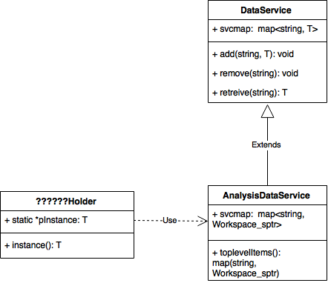
Spot the pattern

Slide 3
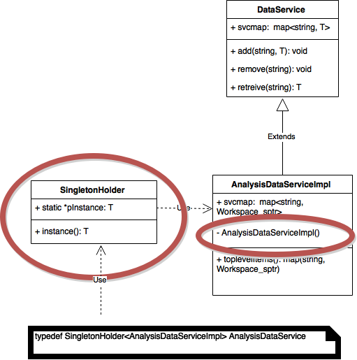
Spot the pattern

Slide 4
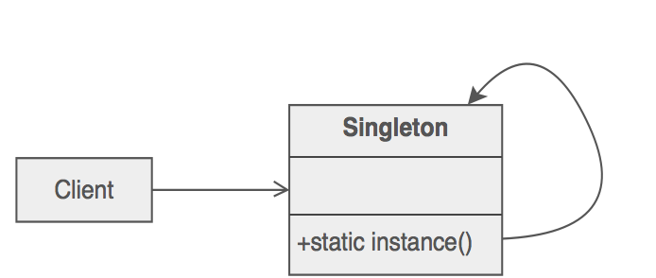
Standard Singleton Implementation

Slide 5
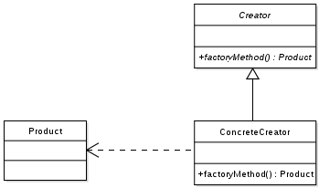
Factory Pattern
Good for separating complex construction logic

Slide 6
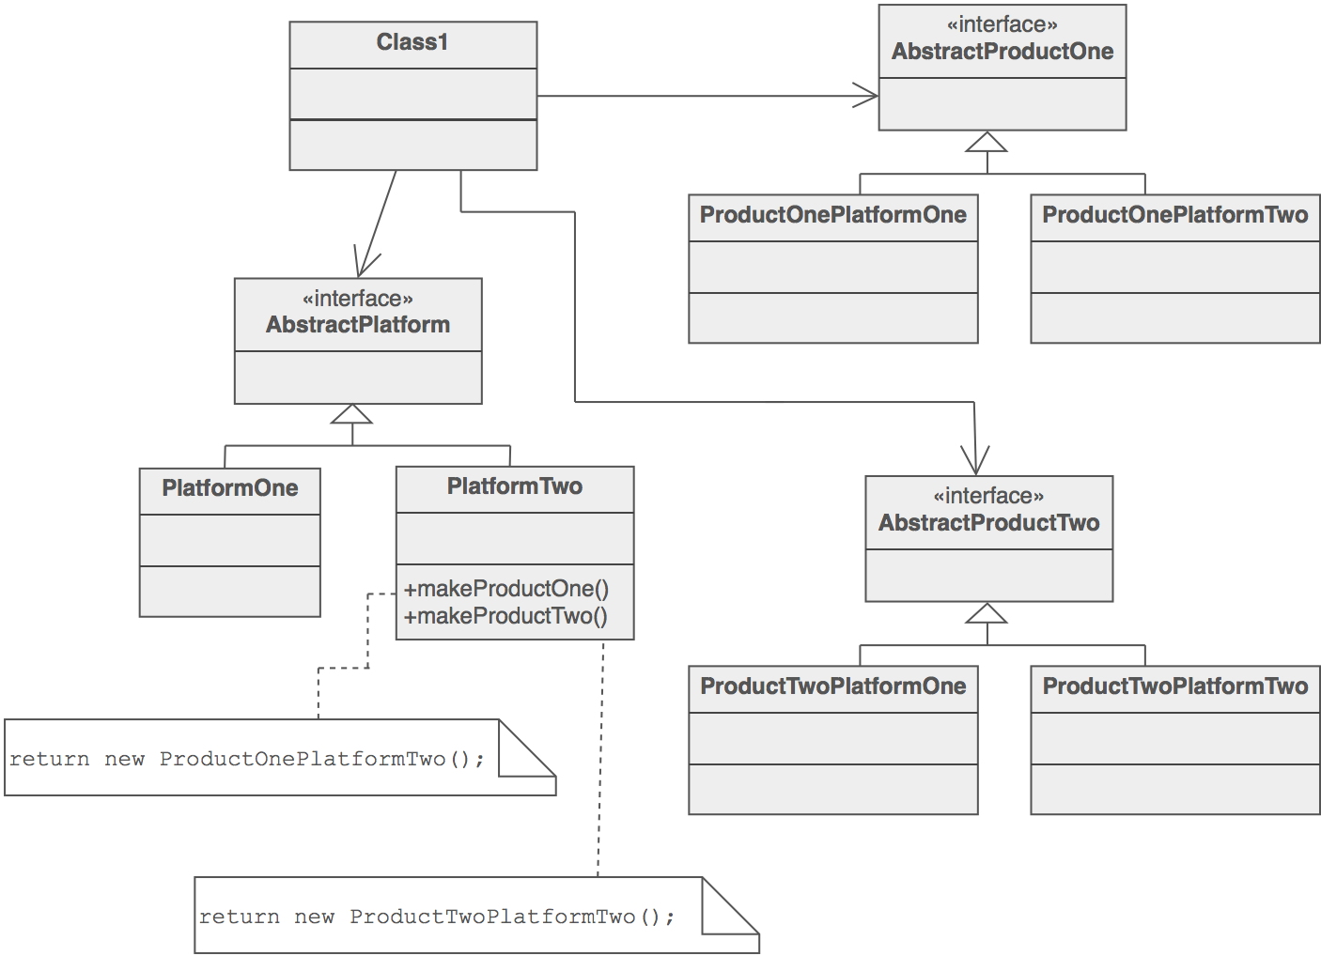
Abstract Factory Pattern
In Mantid?

Slide 7
Abstract Factory Pattern
In Mantid?
ShapeFactory
ObjectFactory

Slide 8
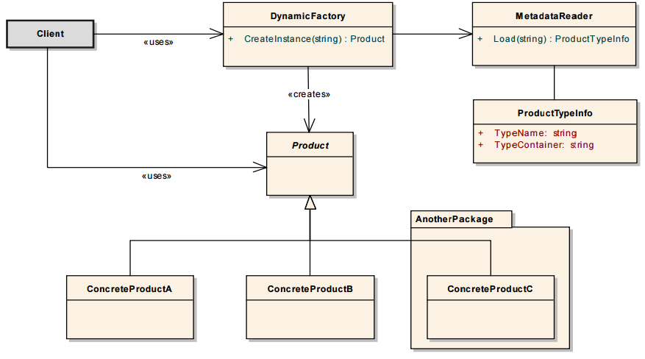
Dynamic Factory Pattern

Slide 9
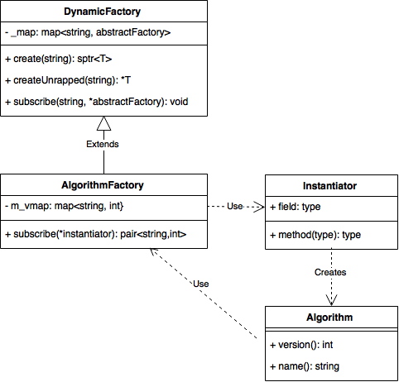
Dynamic Factory in Mantid
In Mantid?
+ create() : T
DECLARE_ALGORITHM(Rebin)
↓
AlgorithmFactory::Instance().subscribe(Instantiator<Rebin>)

Slide 10
Dynamic Factory in Mantid
In Mantid
AlgorithmFactory
ArchiveSearchFactory
CatalogFactory
ColumnFactory
ConstraintFactory
CostFunctionFactory
DomainCreatorFactory
FuncMinimizerFactory
FunctionFactory
ImplicitFunctionFactory
ImplicitFunctionParameterParserFactory
ImplicitFunctionParserFactory
LiveListenerFactory
RemoteJobManagerFactory
ScriptRepositoryFactory
TransformScaleFactory
WorkspaceFactory
LiveListenerFactoryTest
BraggScattererFactory
UnitFactory
ForegroundModelFactory
MDResolutionConvolutionFactory
MDTransfFactory
InterfaceFactory
+ create() : T
DECLARE_ALGORITHM(Rebin)
↓
AlgorithmFactory::Instance().subscribe(Instantiator<Rebin>)

Slide 11
Spot the Pattern

Slide 12
Spot the Pattern
Other uses in Mantid?

Slide 13
Spot the Pattern
Other uses in Mantid
CompositeFunction

Slide 14
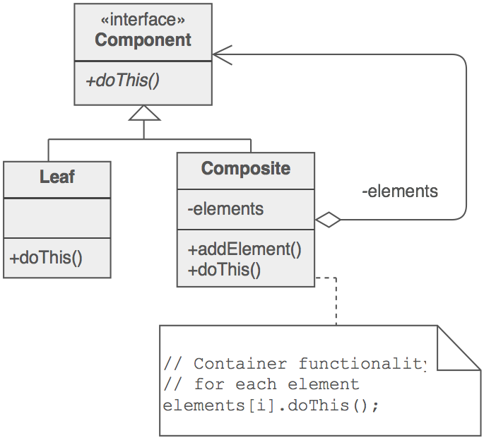
Standard Composite Pattern

Slide 15
Spot the Pattern
alg = FrameworkManager.create(“Rebin”)
alg.setProperty(“InputWorkspace”,”ws1”)
alg.setProperty(“params”,”10,50,2000”)
alg.setProperty(“OutputWorkspace”,”bob”)
alg.execute()
wsOut = alg.getProperty((“OutputWorkspace”)

Slide 16
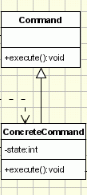
Standard Command Pattern

Slide 17
Command Pattern
Allows the conversion of:
wsOut = Rebin(“ws1”,”bob”,”10,50,2000”)
to
alg = FrameworkManager.create(“Rebin”)
alg.setProperty(“InputWorkspace”,”ws1”)
alg.setProperty(“params”,”10,50,2000”)
alg.setProperty(“OutputWorkspace”,”bob”)
alg.execute()
wsOut = alg.getProperty((“OutputWorkspace”)
Other uses in Mantid?

Slide 18
Command Pattern
Allows the conversion of:
wsOut = Rebin(“ws1”,”bob”,”10,50,2000”)
to
alg = FrameworkManager.create(“Rebin”)
alg.setProperty(“InputWorkspace”,”ws1”)
alg.setProperty(“params”,”10,50,2000”)
alg.setProperty(“OutputWorkspace”,”bob”)
alg.execute()
wsOut = alg.getProperty((“OutputWorkspace”)
Other uses in Mantid
Functions

Slide 19
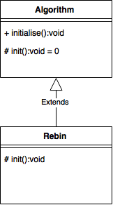
Spot the Pattern

Slide 20
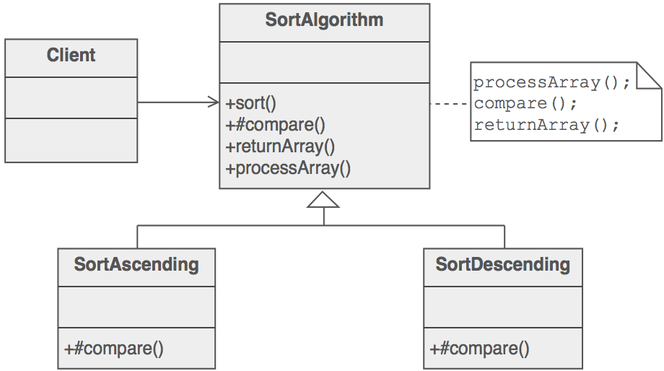
Standard Template Method

Slide 21
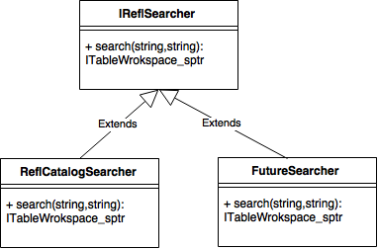
Spot the Pattern

Slide 22
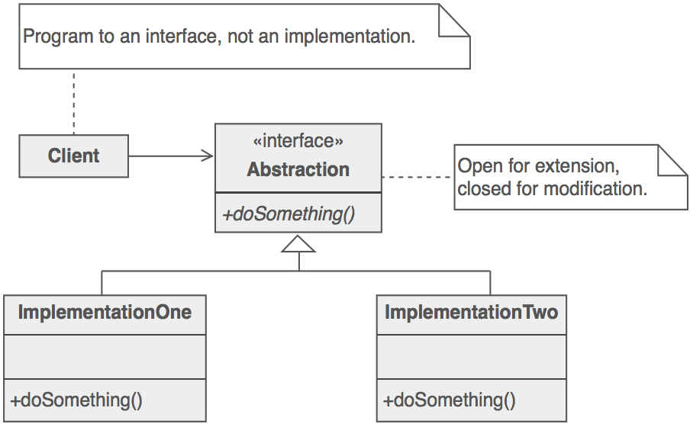
Standard Strategy Method

Slide 23
Useful Resources
Wiki page
http://www.mantidproject.org/Design_Patterns_In_Mantid
GoF patterns with multi language examples
https://sourcemaking.com/design_patterns

